Slide 1
HOUSE RENT APP USING MERN
Team Members
Akilesh.B(211521205011)
Balasubramaniyan.S(211521205021)
Bruno Rethnam.J(211521205026)
Dilli Raj.S(211521205037)

Slide 2
Table of Contents
Abstract
Introduction
Proposed system
Block Diagram
Model screen shot
Conclusion

Slide 3
Abstract
The House Rent App using MERN is a full-stack web application designed to streamline the process of searching for rental properties, inquiring about them, and managing rental transactions. This app integrates user-friendly functionalities like property listings, search filters, user registration, property management, and direct communication with landlords. By leveraging the MERN (MongoDB, Express.js, React.js, and Node.js) stack, the app provides a seamless experience for users, property owners, and admins, ensuring efficient and secure interactions within the rental market.

Slide 4
Introduction
Finding a rental property can often be time-consuming and challenging. With the growing demand for digital solutions in the real estate market, a house rental app offers an effective platform for renters and property owners to connect. The House Rent App is developed using the MERN stack, which is known for its robust backend and dynamic frontend capabilities. The app includes essential features such as property listings, search filters, and an inquiry system to simplify the rental process for users. For property owners, it offers a platform to manage listings and tenant inquiries, while an admin panel ensures the governance of user activities and policy adherence.

Slide 5
Proposed System
The proposed system is a comprehensive house rent application that enables users to browse and rent properties effortlessly. The system includes three main user roles: Renter, Property Owner, and Admin.
Renter: Users like Alice can browse the app, apply filters to search for their desired rental property, view detailed information, and contact property owners. Renters can inquire about properties and proceed with booking confirmations.
Property Owner: Property owners like Bob can create accounts, add their rental properties, and manage listings by updating availability or making changes. Owners also have the option to communicate directly with potential renters through the app.
Admin: The admin ensures platform governance, verifying owner credentials and monitoring user activity. Admins also approve new properties and ensure compliance with the platform's policies.

Slide 6
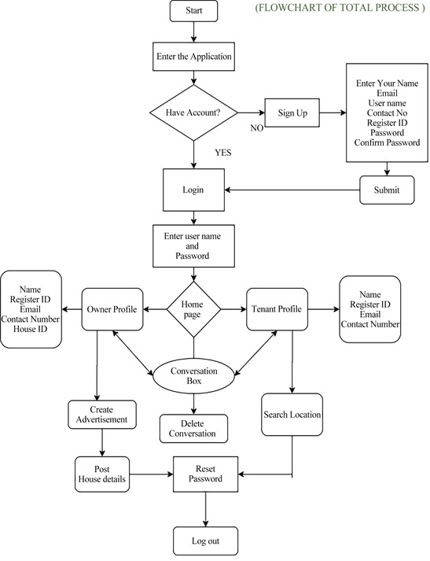
Block Diagram

Slide 7
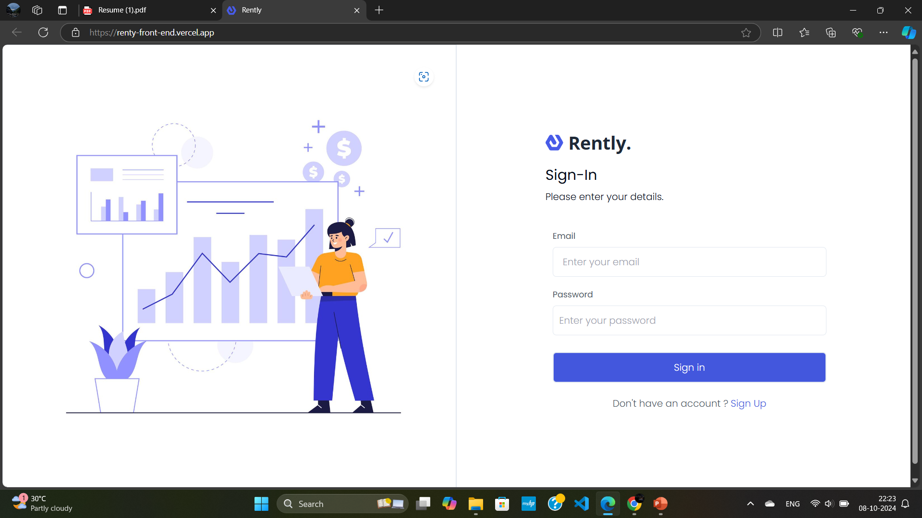
Model Screenshot

Slide 8
Conclusion
The House Rent App using MERN provides a reliable and efficient platform for both renters and property owners. By simplifying the rental process and incorporating key functionalities like property management and real-time communication, the app bridges the gap between users and property managers. The system’s technical architecture ensures scalability, secure data handling, and responsive design, making it an ideal solution for the rental market. Through continued enhancements, the app has the potential to revolutionize the way rental properties are searched and managed.

Slide 9


